Slide 1
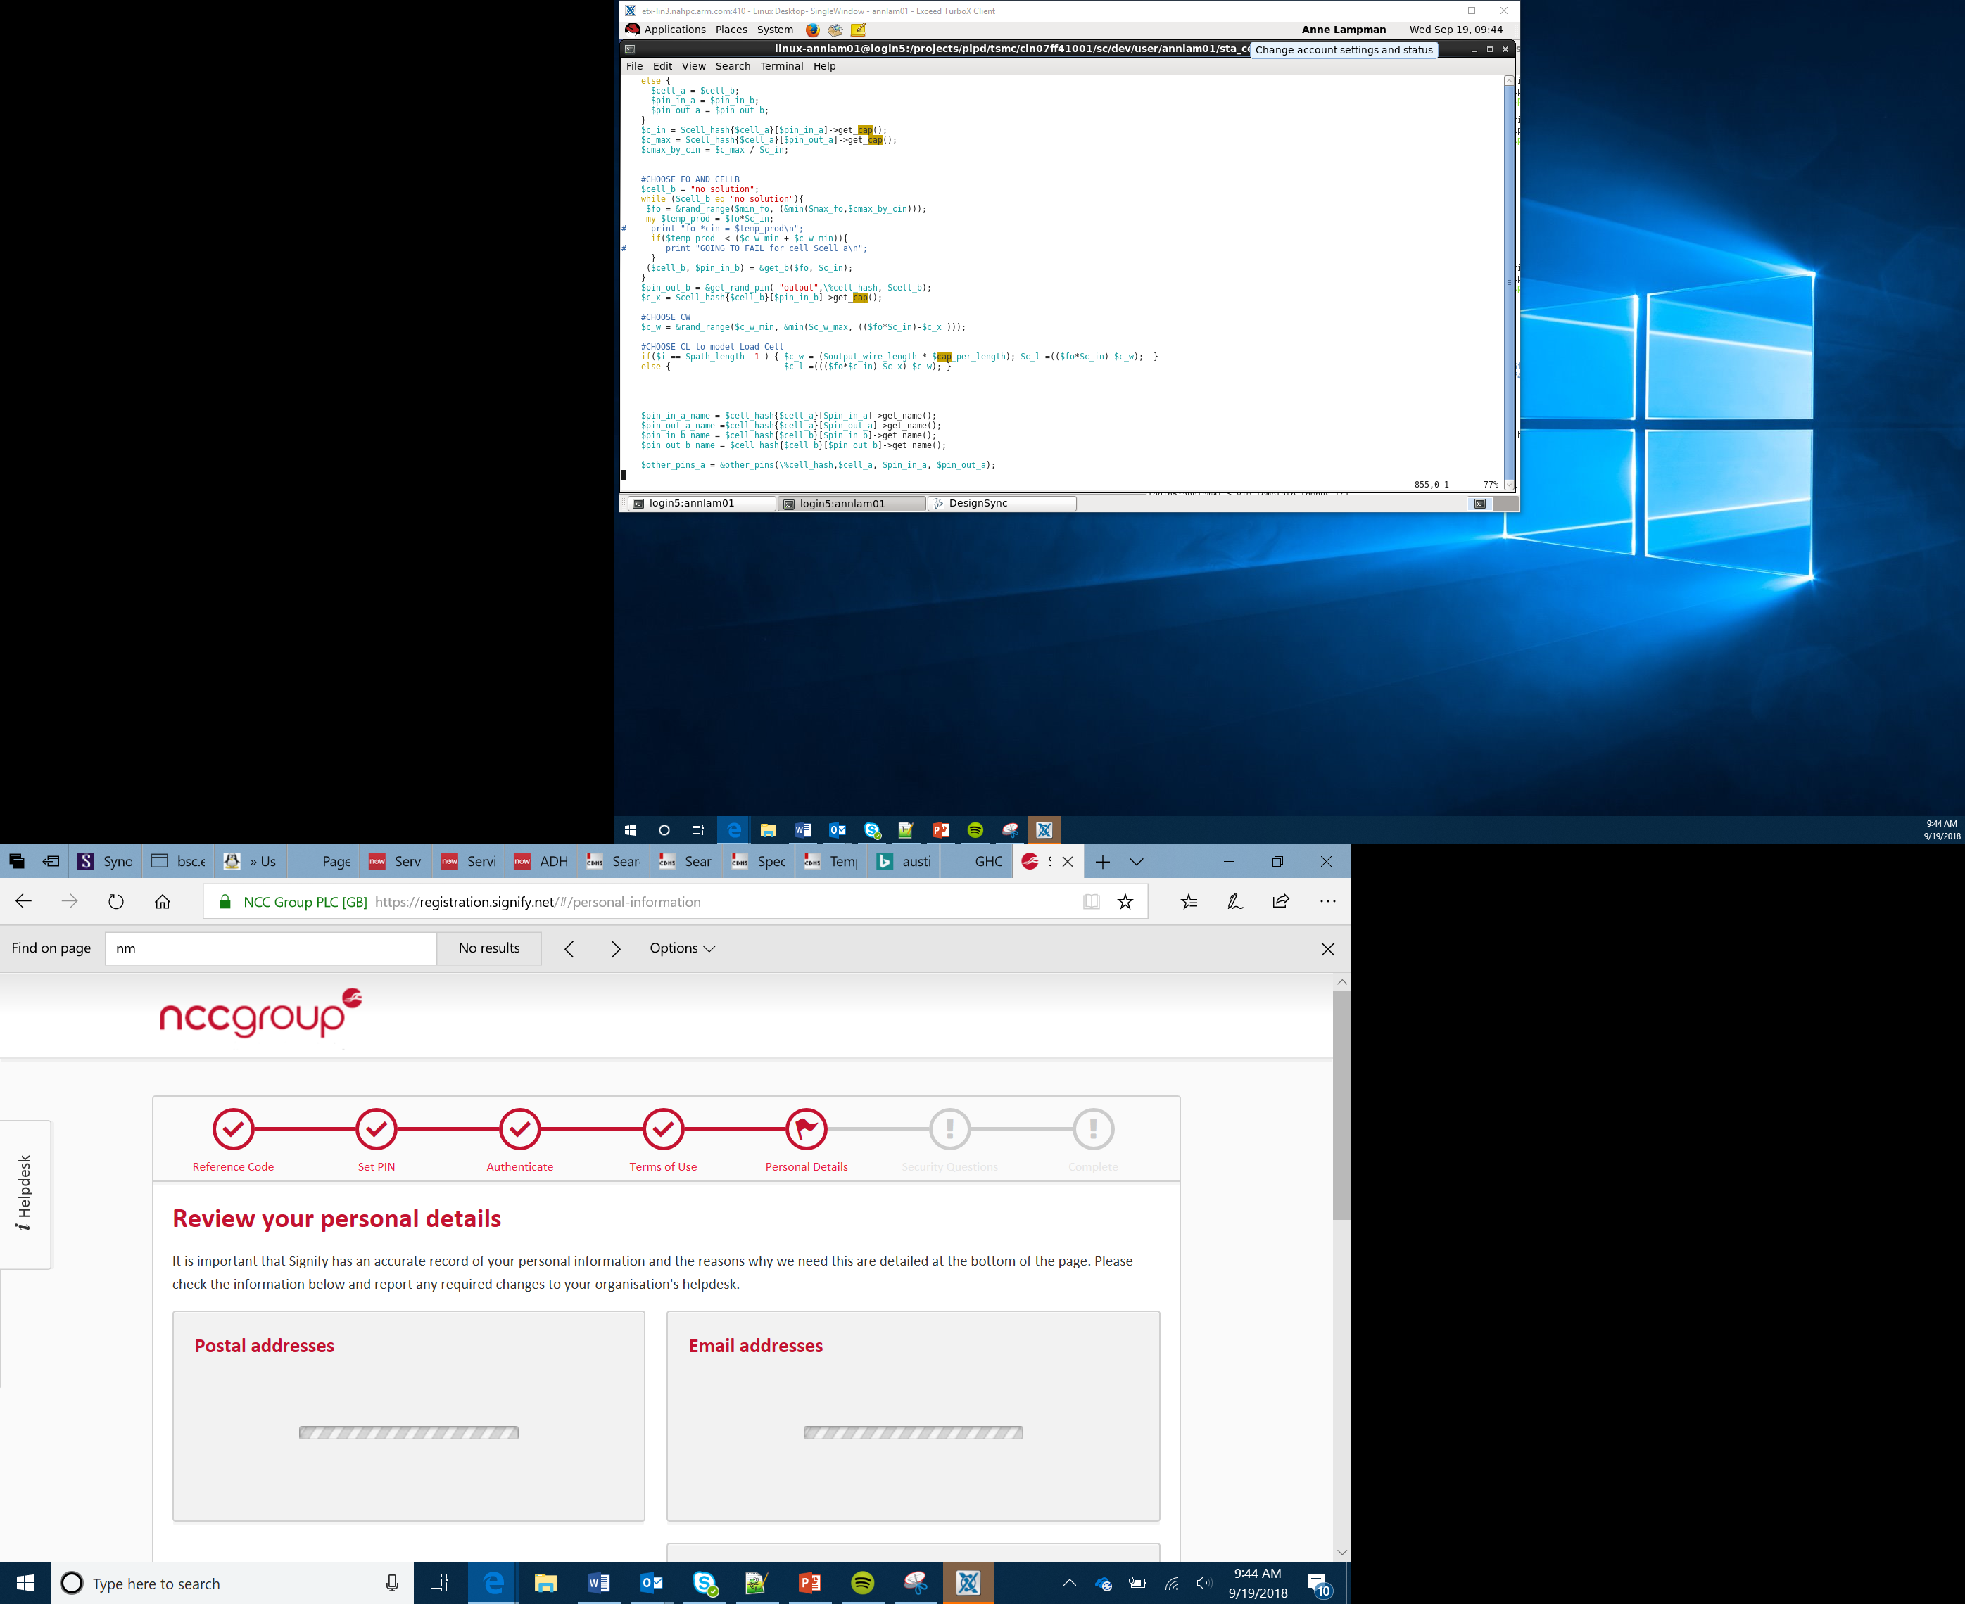

Bit: Bot Race Car Project
Body Shell Mass Production
Lesson 11

Slide 2
Objectives
Apply your understanding of computational thinking and programming skills to achieve a goal
Create prototypes of your design using iterative design cycles
Test and refine your designs using time trials
Produce a mass-production model of your design

Slide 3
Iterative Design and Prototyping - Reminder
Prototyping
Iterative design is a design methodology based on a cyclic process:
Testing
After testing the most recent iteration of a design, changes and refinements are made
This process is intended to ultimately improve the quality and functionality of a design
Revising
Analysing
Notes:
Explain to Learners what iterative design is good reference at Reference https://en.wikipedia.org/wiki/Iterative_design you could revisit the video from Lesson 11 or the Daddy Dollar example here.
Ensure you have resources ready for Learners to develop their design – They have a prototype but will need to consider how this could be mass produced
Enable Learners to test fit and trial run the designs to see how they fit and impact on performance
Start Learners thinking of how their design will be ‘mass produced’

Slide 4
Mass Production
Mass production is the production of large quantities of standardised products often on assembly lines
Having a unique and specialist design is all well and good, but:
It will need to be reproduced
We will need replacements for damaged shells
Sponsorships and branding changes over time
Notes:
Explain the process of mass production
Refer to well known examples such as car production lines Henry Ford or making Jam sandwiches (this could be played out as a sandwich production line bread slicer, butter application, jam application, slicer, wrapper)
Explain to Learners that ‘prototypes’ and real world version often differ. Discuss examples of concept cars (good example https://www.jaguar.co.uk/about-jaguar/concept-cars/index.html) and how sometimes compromised need to be made

Slide 5
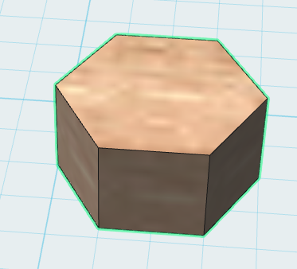
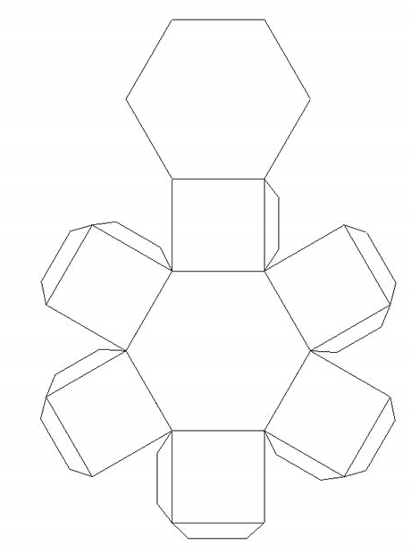
Mass Production
Imagine you had designed a container to store a battery for electric cars and this was your final protype
In order to mass produce this design you would need to create a method of reproducing the prototype on a large scale
You might produce a net for the manufacturing plant to follow
This net would create exact replicas of the original design
Notes:
Discuss the way 3D models can be converted into 2D nets for easy reproduction
You could have some nets of cubes as examples here

Slide 6
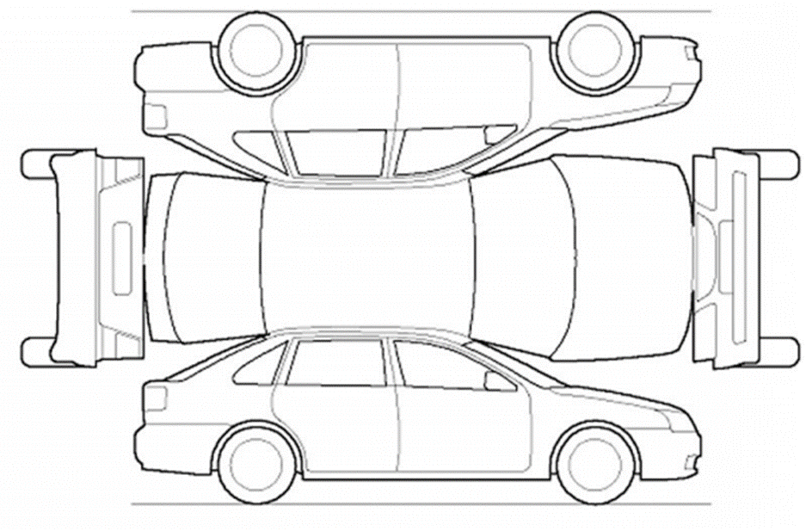
Mass Production
To be able to produce a net or plan you will need to:
Take detailed measurements of your design – remember accuracy is crucial
Reproduce your design using computer software – ensure you have assembly instructions and dimensions
Print/build, fit and reprint/refit until your are able to produce a mass production net that can be printed and assembled quickly by following simple and clear instructions
Notes:
Image taken from http://www.autogeekonline.net/gallery/data/500/medium/PTGTemplate.jpg
Support Learners in creating a net from their prototype
Support Learners in the use of 2D drawing software to recreate their net along with assembly instructions
Work through the Activity Sheet, encourage Stretch Tasks

